Slide 1

Project Details:
AI-Driven Smart Review
System Using
Blockchain
Name: Muhammad Anas
Malaika Mushtaq
Registration Number: Fa22-Bse-014
Fa22-Bse-007
Supervisor Name: Dr Yaser Ali Shah

Slide 2
Introduction:
The Crisis of Trust in Online Reviews:
Problem:
Fake and manipulated reviews cost consumers $152B annually in misguided purchases.
Businesses struggle to get authentic feedback, while reviewers lack incentives.
Our Innovation:
A decentralized review ecosystem that combines:
AI-powered moderation (quality control)
Blockchain transparency (tamper-proof and immutable records)
Cryptocurrency incentives (rewarding reviewers for submitting there genuine reviews)
Why It Matters:
Restores trust for consumers
Provides actionable insights for businesses
Creates a fair, rewarding platform for reviewers

Slide 3
Problem Statement:
Critical Gaps in Today’s Review Systems:
Pervasive Fake Reviews
42% of online reviews are fraudulent (Research 2023)
Consumers waste $152B annually on misrepresented products
No Incentive for Honest Feedback
Reviewers spend time writing feedback with zero rewards
Leads to low-quality, rushed reviews
Centralized Manipulation Risks
Platforms/businesses delete or alter negative reviews
Example: Amazon sellers caught bribing for 5-star reviews
Lack of Transparency
No way to verify if reviews are genuine or the businesses itself submit fake reviews

Slide 4
Problem Solution:
Building Trust Through Technology:
Fake Reviews
Solution:
Blockchain Timestamping: Every review gets a unique, unchangeable hash.
AI Behavioral Analysis: Flags suspicious patterns (e.g., bulk submissions).
No Reviewer Incentives
Solution:
Smart Contract Payments: Auto-sends 1 coin (ERC-20 token) per approved review.
Bonus Pool: 0.5 extra coins if review reaches 10+ likes in 7 days.
Centralized Manipulation
Solution:
Decentralized Storage: Reviews on IPFS(A decentralized protocol for storing and sharing files (like reviews) across a peer-to-peer network) + Ethereum (no single owner).
Public Ledger: Anyone can audit review authenticity.
Lack of Transparency
Solution:
User-Friendly Explorer: Built-in blockchain scanner to verify reviews.
AI Confidence Scores: Shows "% likelihood" review is genuine.

Slide 5
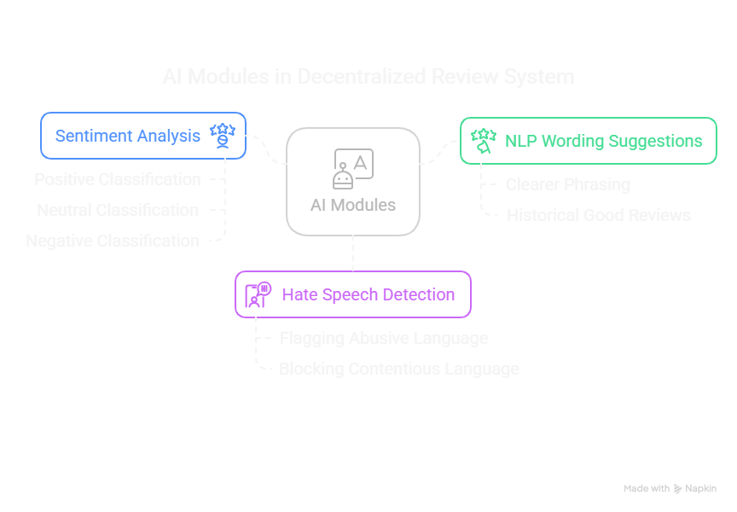
Methodology:
Module 1: AI Moderation Engine
Purpose: Ensure high-quality, constructive reviews
Sub-Components:
NLP Wording Suggestions: Recommends
clearer phrasing based on historical "good" reviews.
Hate Speech Detection: Flags and blocks
abusive/contentious language (e.g., racism, threats).
Sentiment Analysis: Classifies reviews as
Positive/Neutral/Negative for business insights.

Slide 6
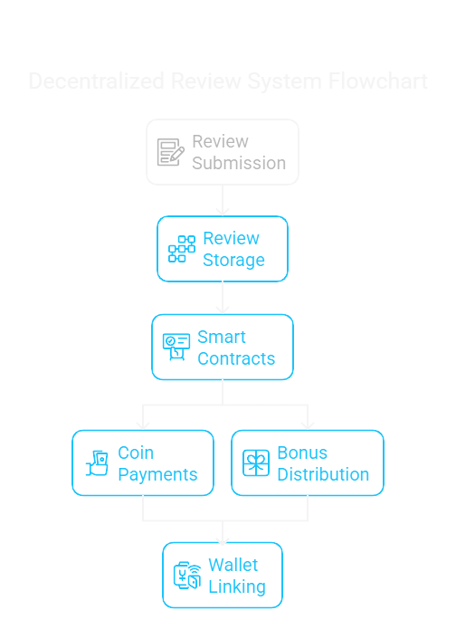
Methodology:
Module 2: Block chain Integration
Purpose: Guarantee transparency and immutability
Sub-Components:
Review Submissions: Submit review blockchain.
Review Storage: Hashes review data + metadata stored on-chain (Ethereum/IPFS).
Smart Contracts: Auto-execute:
Coin payments to reviewers.
Like-based bonus distribution.
Wallet Linking: Users connect MetaMask/Trust Wallet to receive coins.

Slide 7
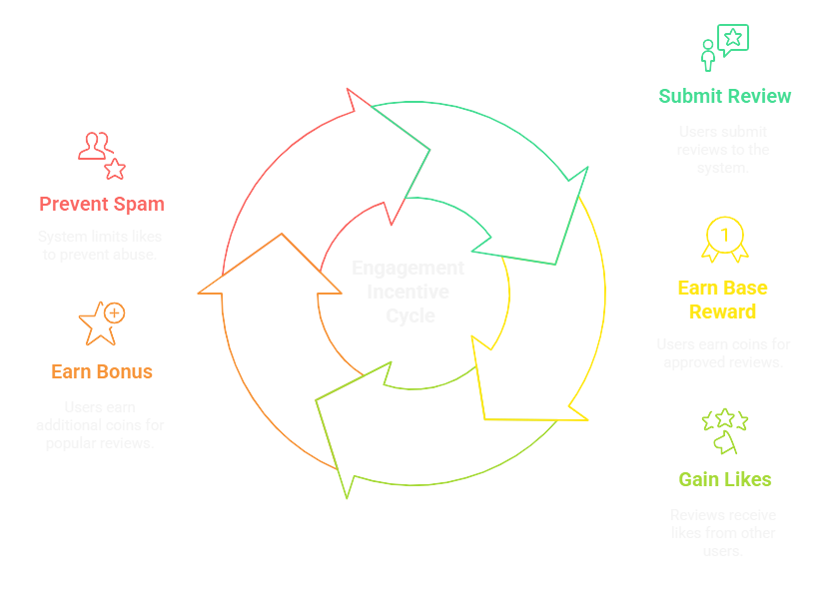
Methodology:
Module 3: Reward & Like
Purpose: Incentivization and user motivation
Sub-Components:
Review Submissions: Submit review blockchain.
Review Storage: Hashes review data + metadata stored
on-chain (Ethereum/IPFS).
Smart Contracts: Auto-execute:
Coin payments to reviewers.
Like-based bonus distribution.
Wallet Linking: Users connect MetaMask/Trust Wallet
to receive coins.

Slide 8
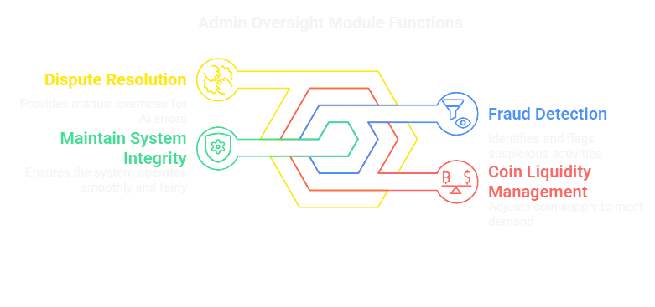
Methodology:
Module 4: Admin Oversight
Purpose: Maintain system integrity
Functions:
Fraud Detection: AI flags suspicious patterns (e.g., sudden review spikes).
Coin Liquidity Management: Adjusts coin supply based on demand.
Dispute Resolution: Allows manual review overrides if AI errors.

Slide 9
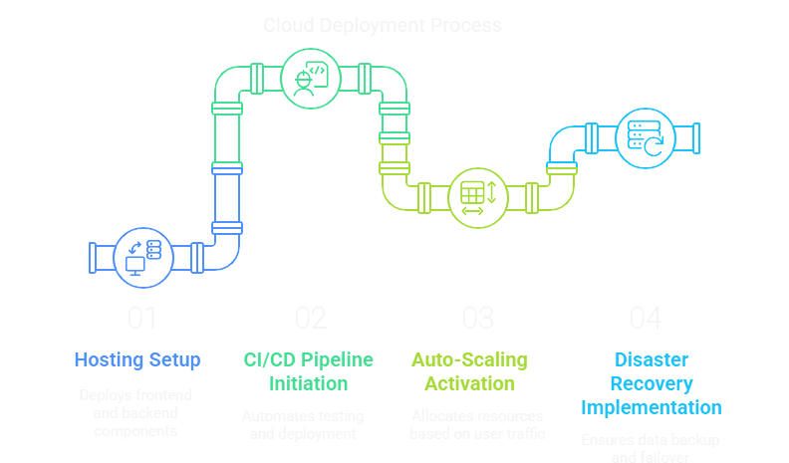
Methodology:
Module 5: Cloud Deployment
Purpose: Ensure scalability, reliability, and continuous delivery
Components:
AWS/GCP Hosting
Frontend: Deployed on S3/Cloud Storage (static files)
Backend: Containerized with Docker + orchestrated via Kubernetes
CI/CD Pipeline
Automated testing (unit/integration) with GitHub Actions/Jenkins
Zero-downtime deployments using Blue-Green strategy
Auto-Scaling
Dynamic resource allocation based on traffic (e.g., 100→10,000 users)
Cost-optimized with spot instances for non-critical workloads
Disaster Recovery
Daily automated backups (RDS/Snapshots)
Multi-region failover (if primary zone crashes)

Slide 10
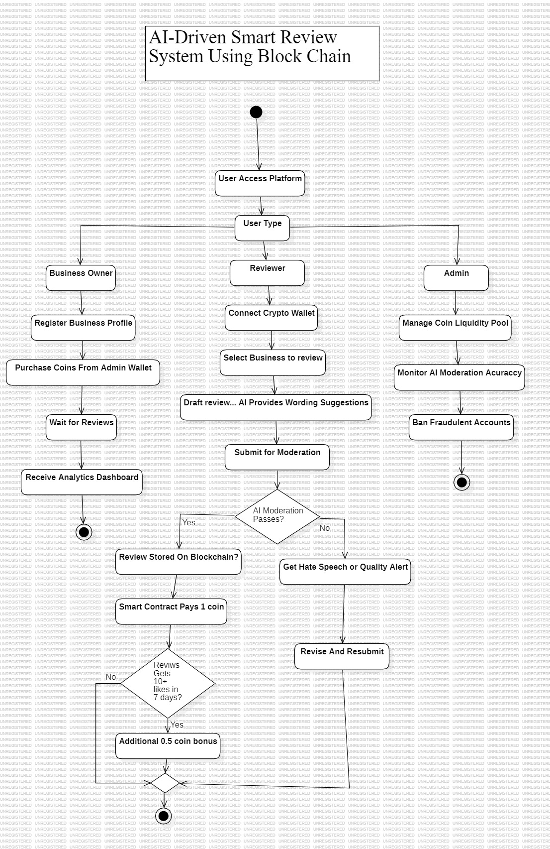
Methodology:
Flow Chart of the system:

Slide 11
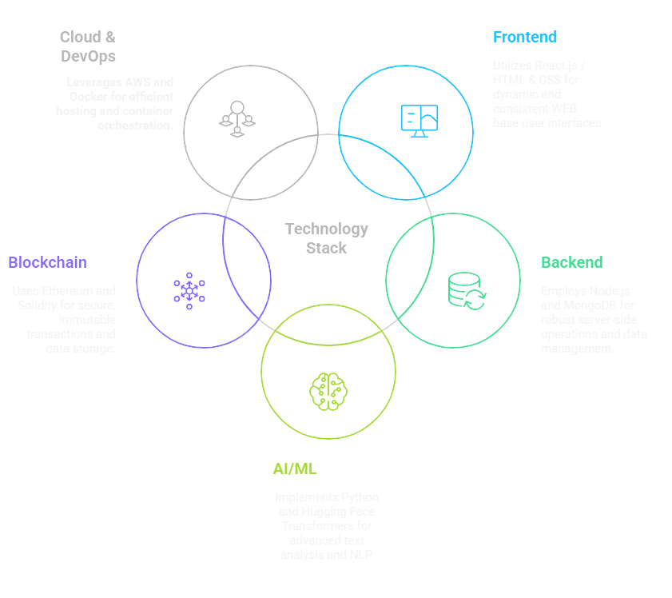
Tech Stack:
Built for scale and security:
1. Frontend
React.js (Dynamic UI for businesses/reviewers)
HTML & CSS (Semantic markup + styling)
Web3.js (Blockchain wallet integration)
2. Backend
Node.js + Express (RESTful APIs)
MongoDB (User profiles, business data)
Redis (Session caching)
3. AI/ML
Python (Core NLP)
Hugging Face Transformers (Pre-trained
BERT for text analysis)

Slide 12
Tech Stack:
Built for scale and security:
4. Blockchain
Ethereum/Hyperledger (Immutable storage)
Solidity (Smart contracts for payments)
IPFS (Decentralized review storage)
5. Cloud & DevOps
AWS/GCP (EC2/Compute Engine for hosting)
Docker + Kubernetes (Container orchestration)
GitHub Actions (CI/CD pipelines)

Slide 13
Comparative Analysis:
Analysis with existing system:
Feature/ Criteria | Trustpilot | Steemit | Google Reviews | Proposed System
Trust Mechanism | Centralized (Company-controlled) | Decentralized (Community votes) | Centralized (Google-controlled) | Hybrid (Blockchain + AI verification)
Fake Review Prevention | Manual reporting + basic algorithms | No AI moderation | Algorithmic detection | NLP analysis + on-chain immutability
Incentivization | No rewards | STEEM tokens for upvotes | No rewards | Base coins + bonus for likes
Moderation | Human + Basic AI | Community voting only | Automated filters | speech detection + constructive feedback scoring
Transparency | Company can remove reviews | Public blockchain | Google can alter visibility | IPFS + Blockchain storage
Scalability | High (Centralized servers) | Slow | High (Google Cloud) | Private blockchain/Layer 2 solution
User Control | Limited (Trustpilot owns data) | Users own content | Google owns data | Wallet-owned data + decentralized identity

Slide 14
Work Breakdown Structure:
Analysis with existing system:
ID | Task | Duration
1 | User Management (M1 + M2 + M8) | 28 days
1.1 | Reviewers Authentication (M1) | 7 days
1.2 | Business Registration (M2) | 7 days
1.3 | Wallet Integration (M8) | 14 days
2 | Core Functionalities (M4 + M5 + M6 + M7) | 70 days
2.1 | Review Submission (M4) | 14 days
2.2 | Ai Modules (M5) | 20 days
2.3 | Block chain integration (M6) | 24 days
2.4 | Like reward (M7) | 12 days
3 | Admin & Infrastructure (M3 + M9 + M10) | 62 days
3.1 | Admin dashboard (M3) | 20 days
3.2 | Cloud deployment (M9) | 20 days
3.3 | Testing and Debugging (M10) | 15 days
3.4 | Final documentation | 7 days

Slide 15
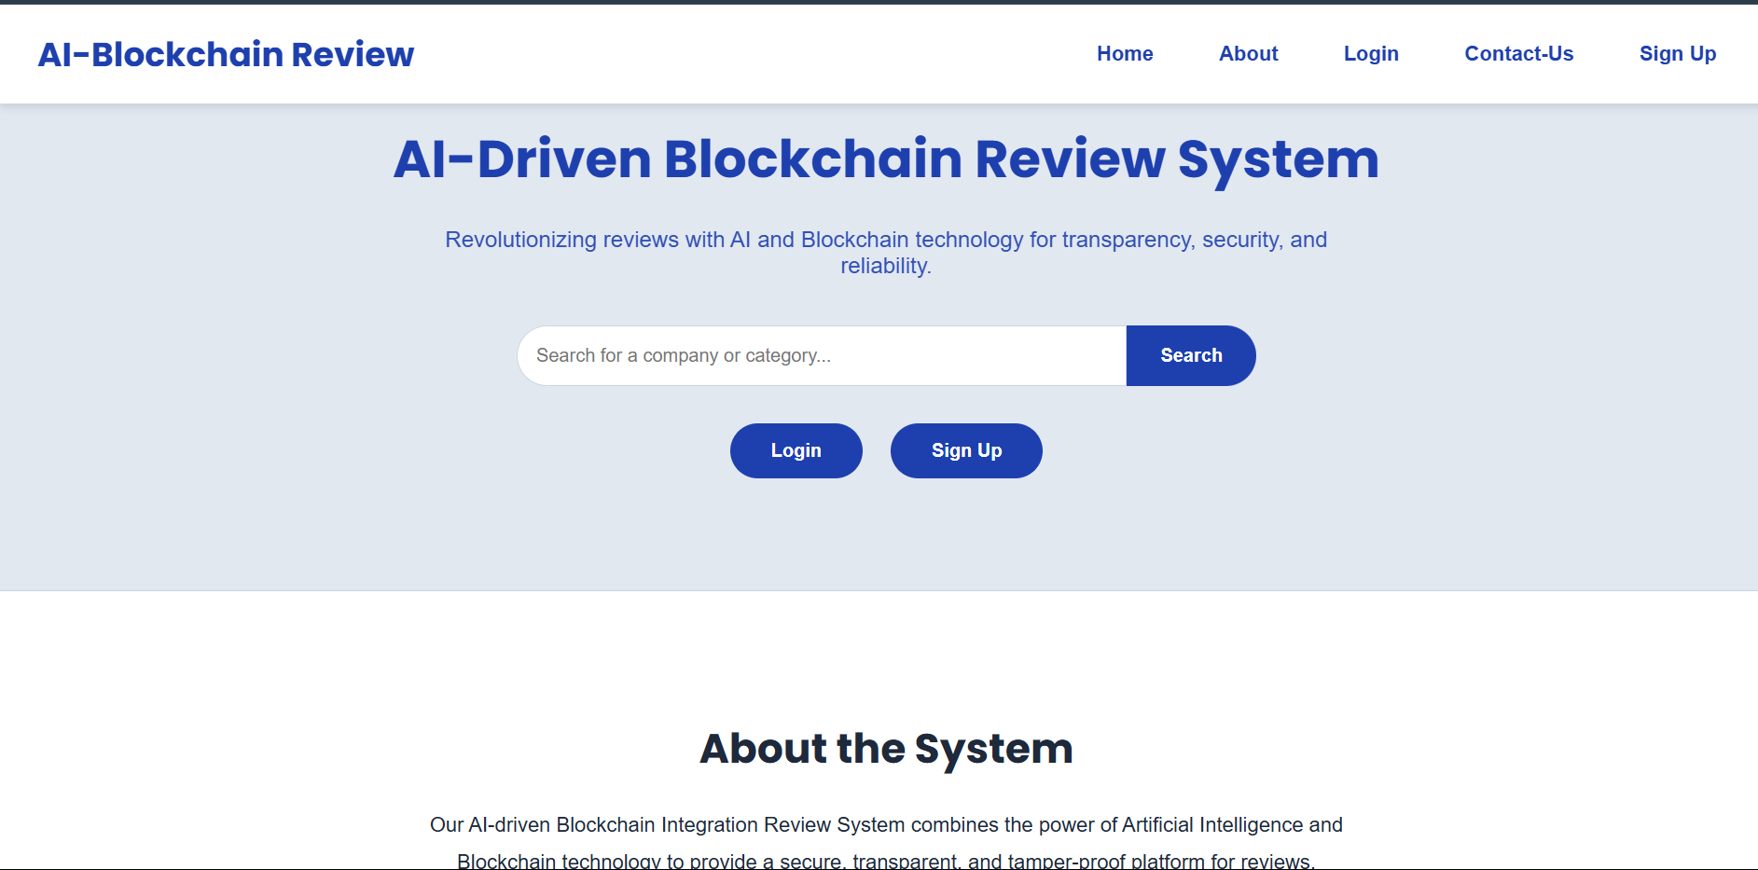
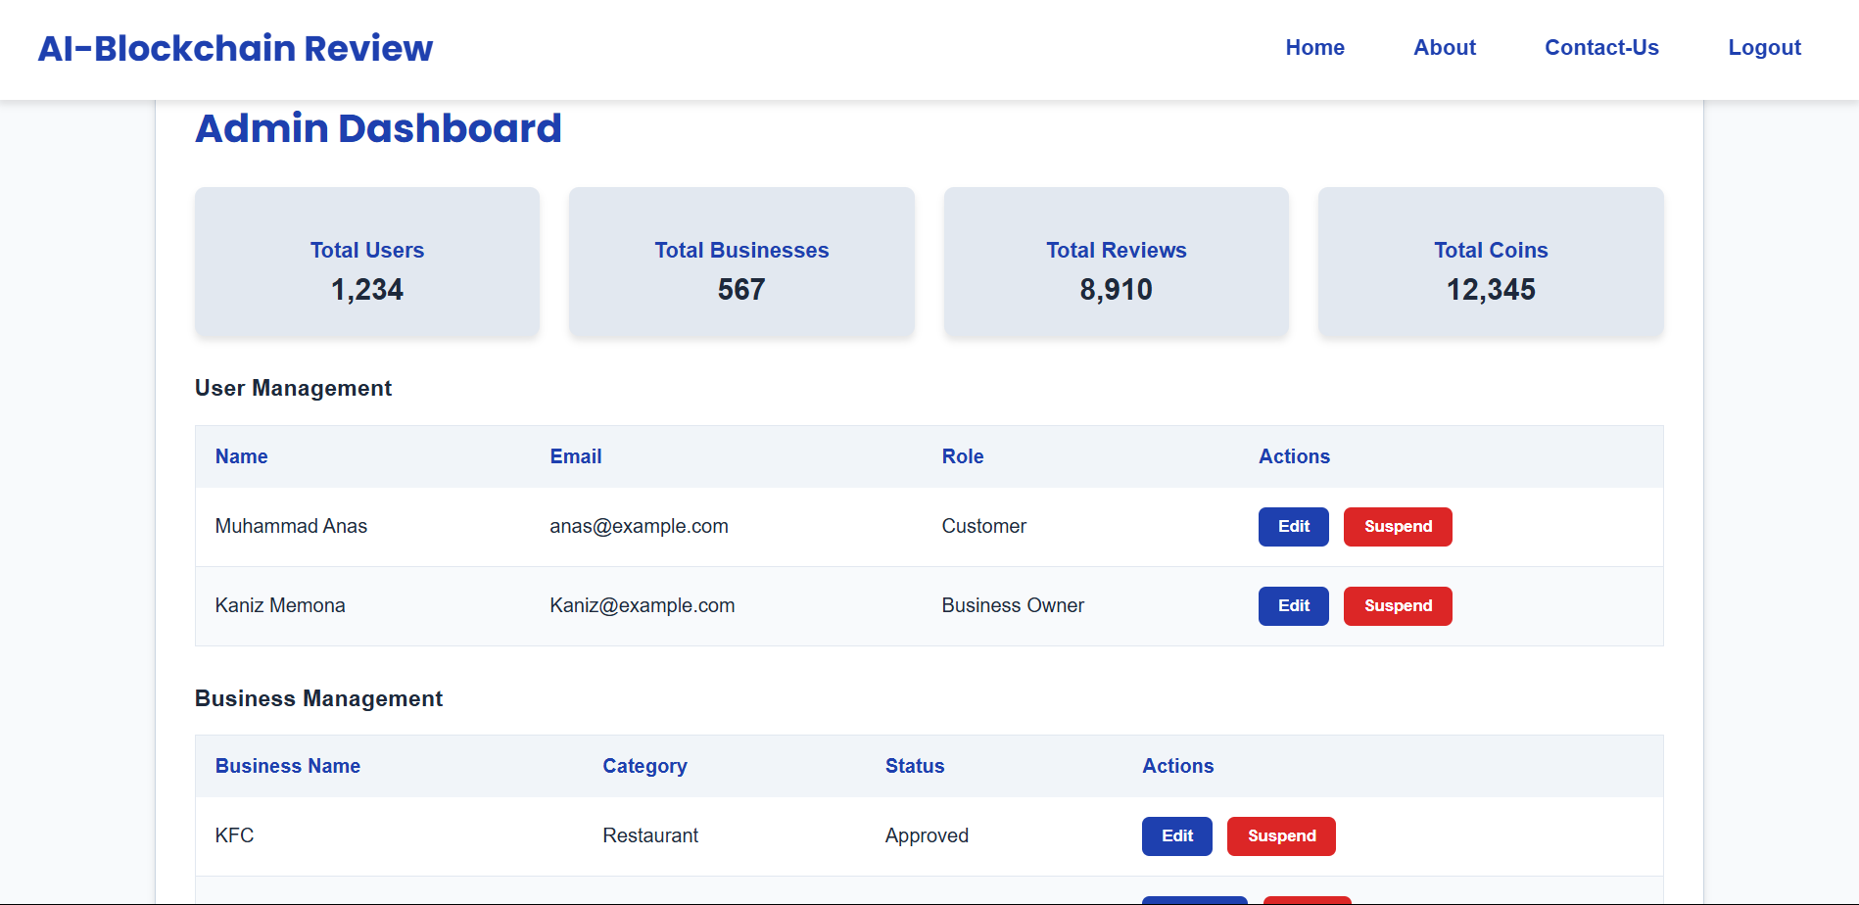

Slide 16
Thank You so much
Any Question…?

